Slide 1

DAYANANDA SAGAR COLLEGE OF ENGINEERING Shavige Malleshwara Hills, Kumaraswamy Layout, Bangalore-560078 (An Autonomous Institute affiliated to VTU, Approved by AICTE &ISO 9001: 2008 Certified) Accredited by National Assessment & Accreditation Council (NAAC) with ‘A’ Grade Department of Mechanical Engineering (Accredited by NBA Tier-1) Subject: Dassault system Internship Semester: 7th
Title | Students Name & USN | Affiliation
Analysis of Turbocharger | Aman Kumar-1DS21ME010 | Department of Mechanical Engineering, Dayananda Sagar College of Engineering

Slide 2
Turbocharger
Turbocharger Function: A turbocharger increases engine power by using exhaust gases to spin a turbine, which drives a compressor that forces more air (and oxygen) into the engine’s intake, allowing it to burn more fuel and produce more power.
Key Components: A turbocharger consists of three main parts: the turbine, compressor, and shaft that connects them. The turbine spins from exhaust gases, which then drives the compressor to compress air entering the engine.
Benefits: Turbochargers increase engine efficiency and power without needing a larger engine, improving fuel economy while providing a performance boost, especially in smaller engines.

Slide 3
Turbine Effect
P
V
This graph shows the variation of pressure (P) and velocity (V) within a turbine, which is commonly used in a turbocharger. As the exhaust gases enter the turbine, the pressure decreases along the flow path, indicating energy extraction from the exhaust to drive the turbine. Simultaneously, the velocity initially increases due to the conversion of pressure energy into kinetic energy, then decreases as energy is transferred from the gases to the turbine wheel. This energy drives the compressor, enabling forced induction for improved engine efficiency and power output.

Slide 4
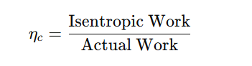
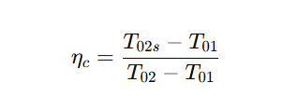
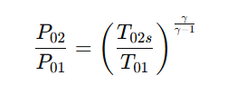
Formulae
1. Compressor Isentropic Efficiency (ηₛₒ)
The efficiency of a compressor is often defined as the ratio of the ideal (isentropic) work to the actual work required to achieve the same pressure ratio. For isentropic efficiency:
​​
where:
T01​ = compressor inlet total temperature,
T02​ = actual outlet total temperature,
T02s​ = isentropic outlet total temperature.
2. Compressor Pressure Ratio and Temperature Relationship
​where:
P01,P02​ are inlet and outlet pressures,
gamma is the ratio of specific heats (γ=cp/cv​​​).

Slide 5
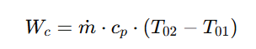
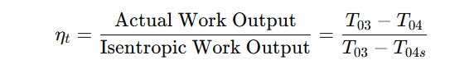
3. Compressor Power Requirement
The power required by the compressor (Wc) is based on the mass flow rate (m˙) and specific enthalpy rise:
where cp​ is the specific heat capacity at constant pressure.
4. Turbine Isentropic Efficiency (ηₜ)
Similar to the compressor, the turbine efficiency compares the actual work to the ideal work output under isentropic conditions:
​​where:
T03​ is the turbine inlet total temperature
T04​ is the actual outlet total temperature
T04s​ is the isentropic outlet total temperature

Slide 6
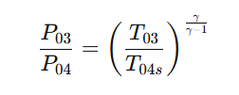
5. Turbine Pressure Ratio and Temperature Relationship
For isentropic expansion in the turbine, the pressure ratio relates to temperatures as follows:
where,P03​ and P04​ are the inlet and outlet pressures for the turbine.
6. Turbocharger Shaft Power Balance
Since the turbine and compressor are on a common shaft, their power output and input must balance, ignoring mechanical losses:

Slide 7
Simulation
Simulation is the process of creating a model or representation of a real-world system, process, or phenomenon in order to study its behavior under different conditions, without physically experimenting with the actual system.
Use mathematical models to simulate systems, typically involving calculations with computers (e.g., Finite Element Analysis (FEA), Computational Fluid Dynamics (CFD)).

Slide 8
CFD
CFD stands for Computational Fluid Dynamics.
It is a simulation technique used to analyze and predict fluid flow behavior.
Uses numerical methods and algorithms to solve fluid dynamics equations.
FEA
FEA stands for Finite Element Analysis.
Numerical method used to solve complex engineering problems related to structural, thermal, fluid, and electromagnetic systems by breaking them down into smaller, simpler parts

Slide 9
Why CFD in turbocharger?
Airflow Efficiency: CFD helps in simulating airflow through the compressor and turbine blades to optimize their shapes, angles, and sizes for better efficiency.
Inlet and Outlet Flow: Analyzing how air enters and exits the turbocharger components allows for optimization of flow paths and pressure distribution, reducing losses.
Exhaust Gas Flow: The turbine side of a turbocharger deals with high-temperature exhaust gases. CFD helps model the temperature distribution and thermal stresses within the turbine components.
Cooling Analysis: Simulating heat transfer allows engineers to design better cooling systems for both the turbine and compressor sections, improving overall efficiency and preventing overheating.
Matching Performance: The compressor and turbine in a turbocharger need to be matched for optimal performance across different engine speeds and loads. CFD helps in analyzing the balance between these components to ensure smooth operation and high efficiency.
Blade Design: CFD can optimize the design of both the compressor blades and turbine blades, allowing for improvements in aerodynamic performance and overall energy conversion efficiency.

Slide 10
Steps in Simulation
Pre-Processing
Initialization
Post Processing

Slide 11
Input Parameters Reference:Watson, N. (2006). Turbochargers. Wiley.
Inlet temperature is between 1000K-1200K.
Turbine speed is between 50,000-1,20,0000 rpm.
Exhaust input mass flow rate is 0.5kg/s.

Slide 12
Turbocharger Assembly

Slide 13
PRE-PROCESSING

Slide 14
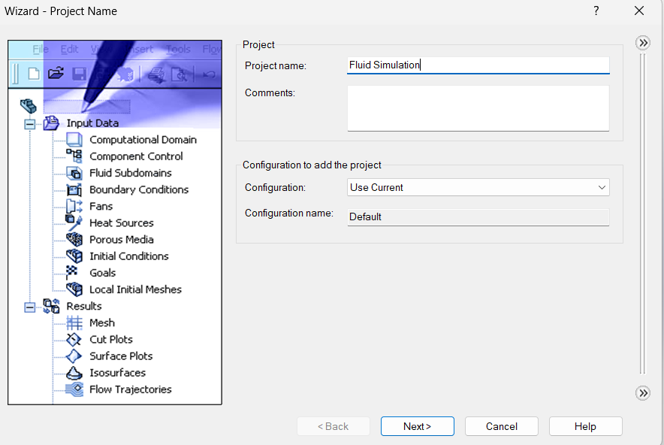

Slide 15
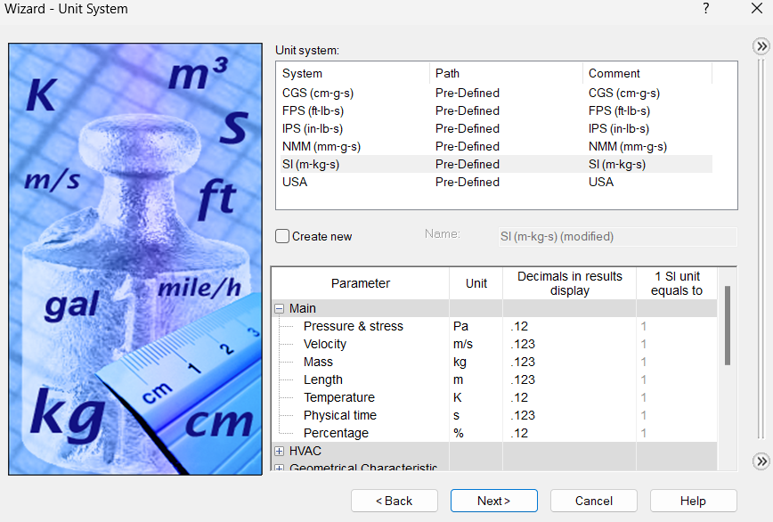

Slide 16
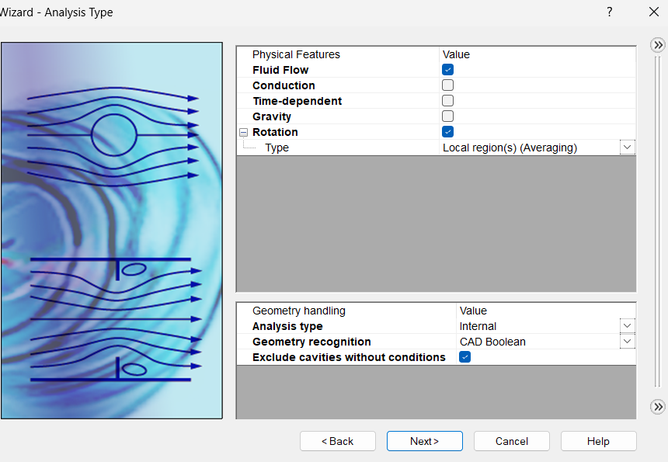

Slide 17
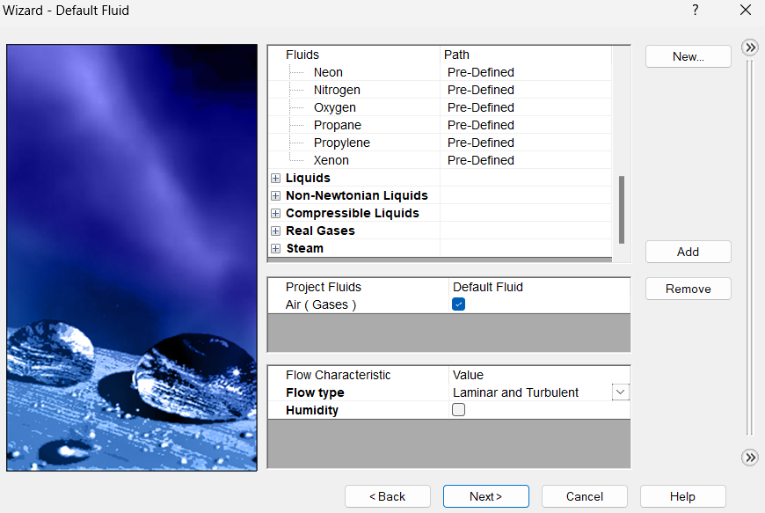

Slide 18
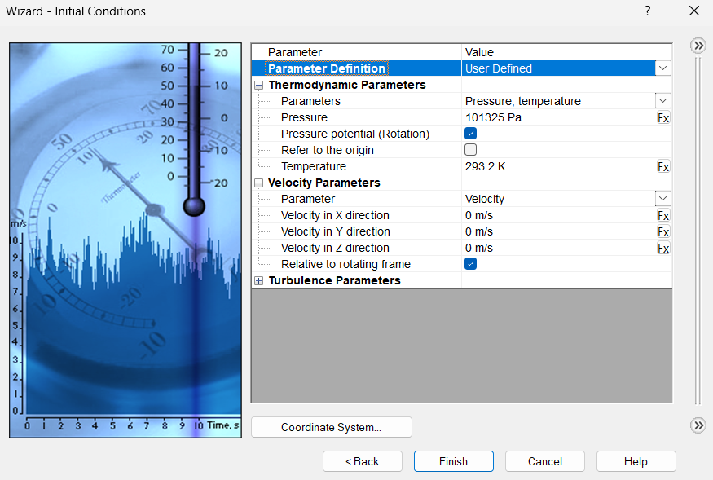

Slide 19
INITIALIZATION

Slide 20
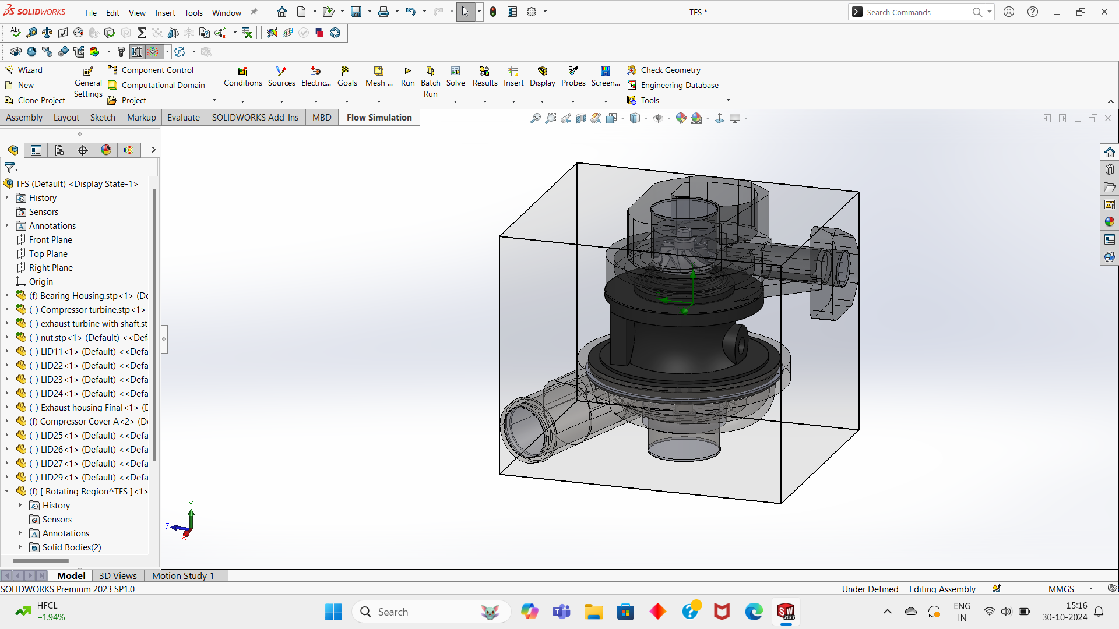

Slide 21
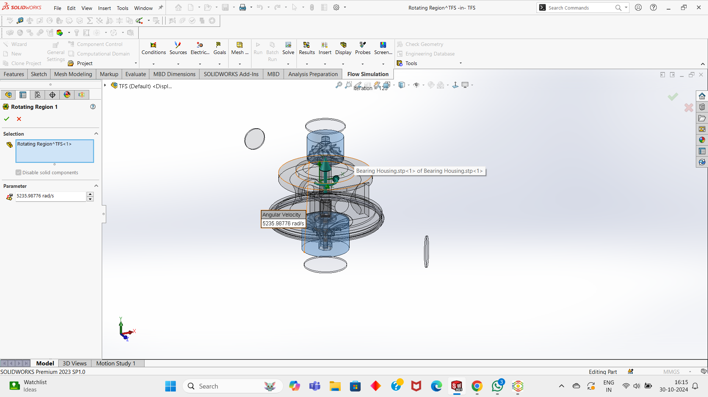

Slide 22
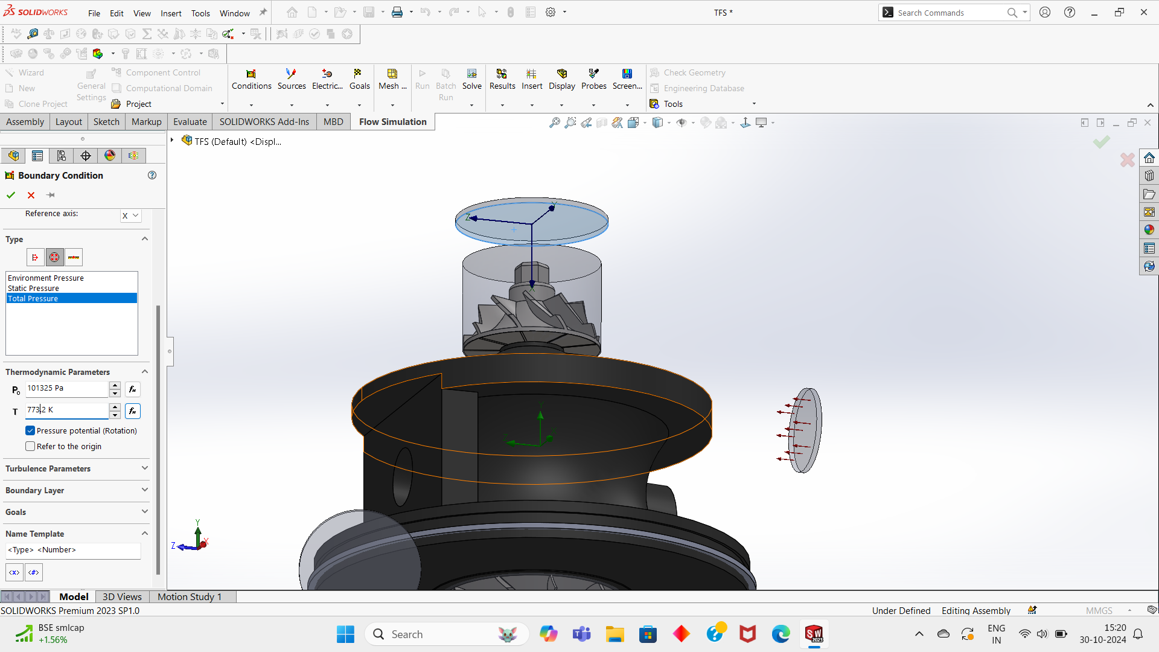

Slide 23
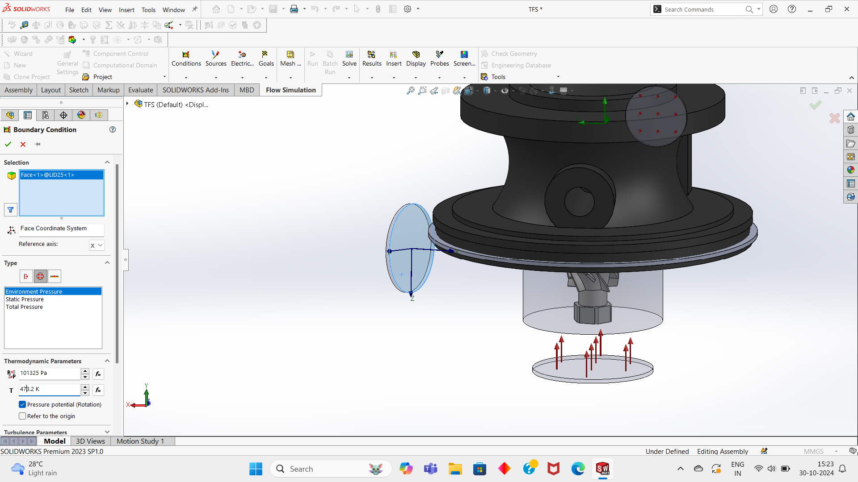

Slide 24
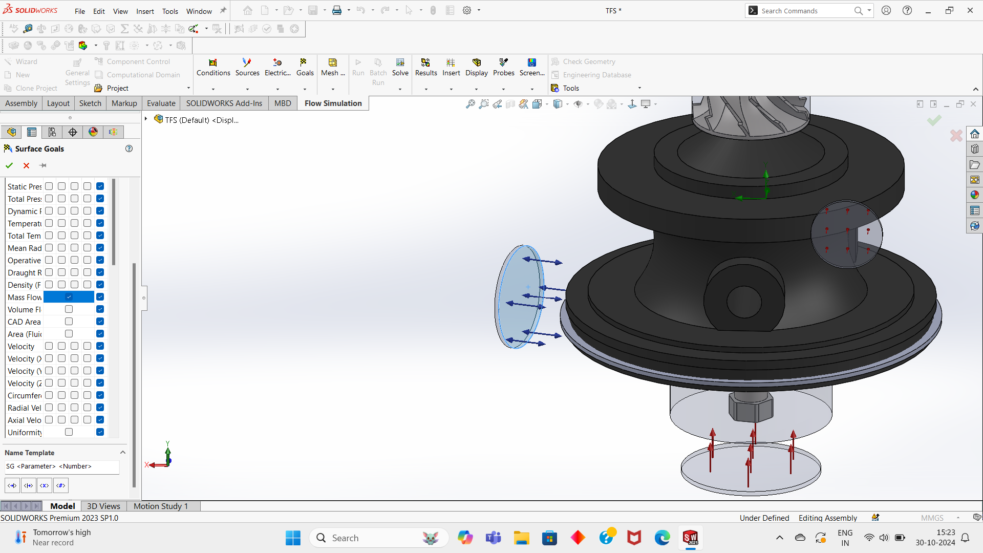

Slide 25
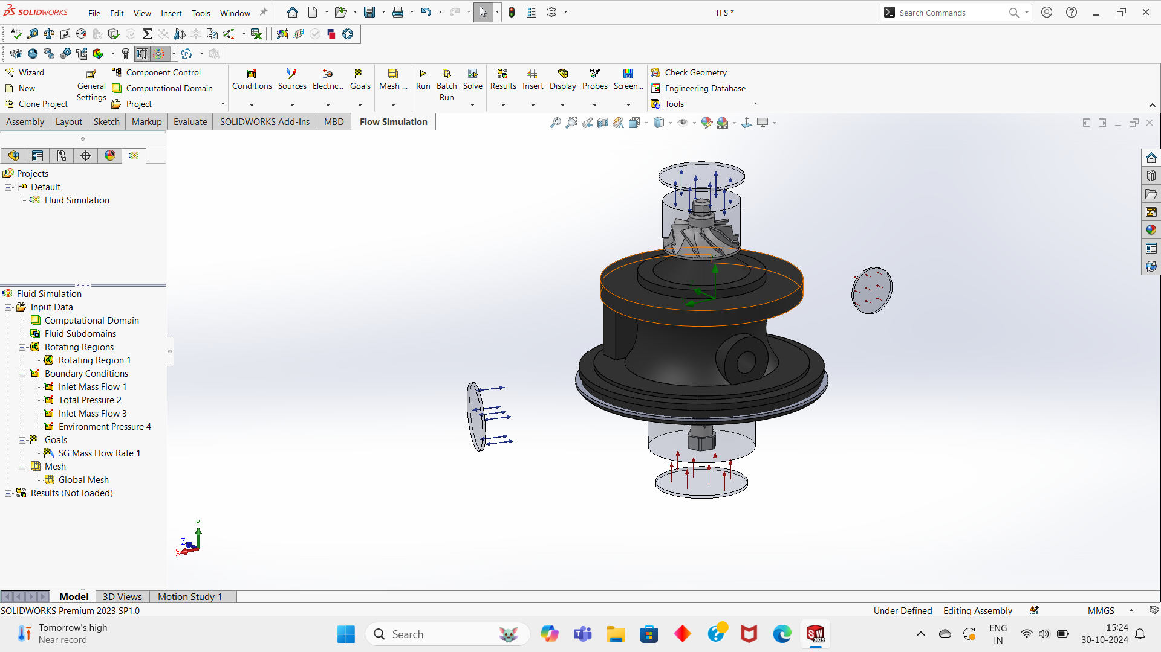

Slide 26
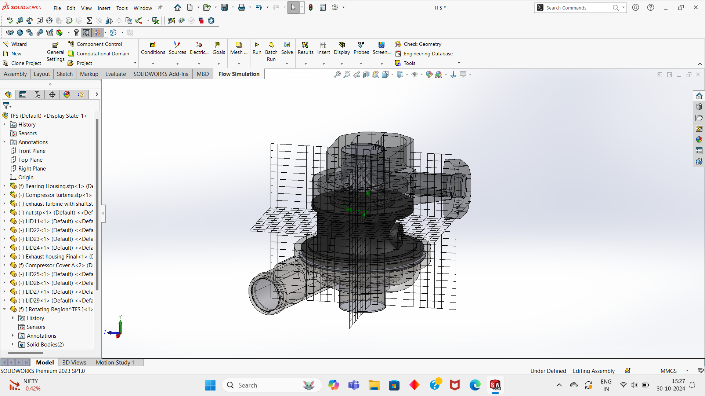

Slide 27
POST-PROCESSING

Slide 28
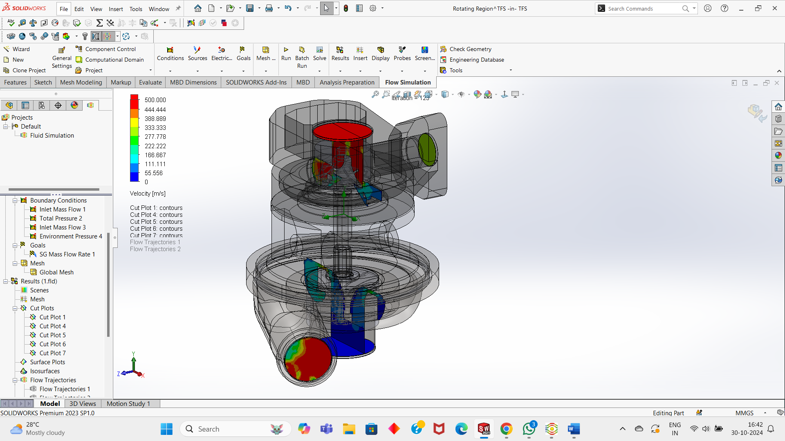

Slide 29
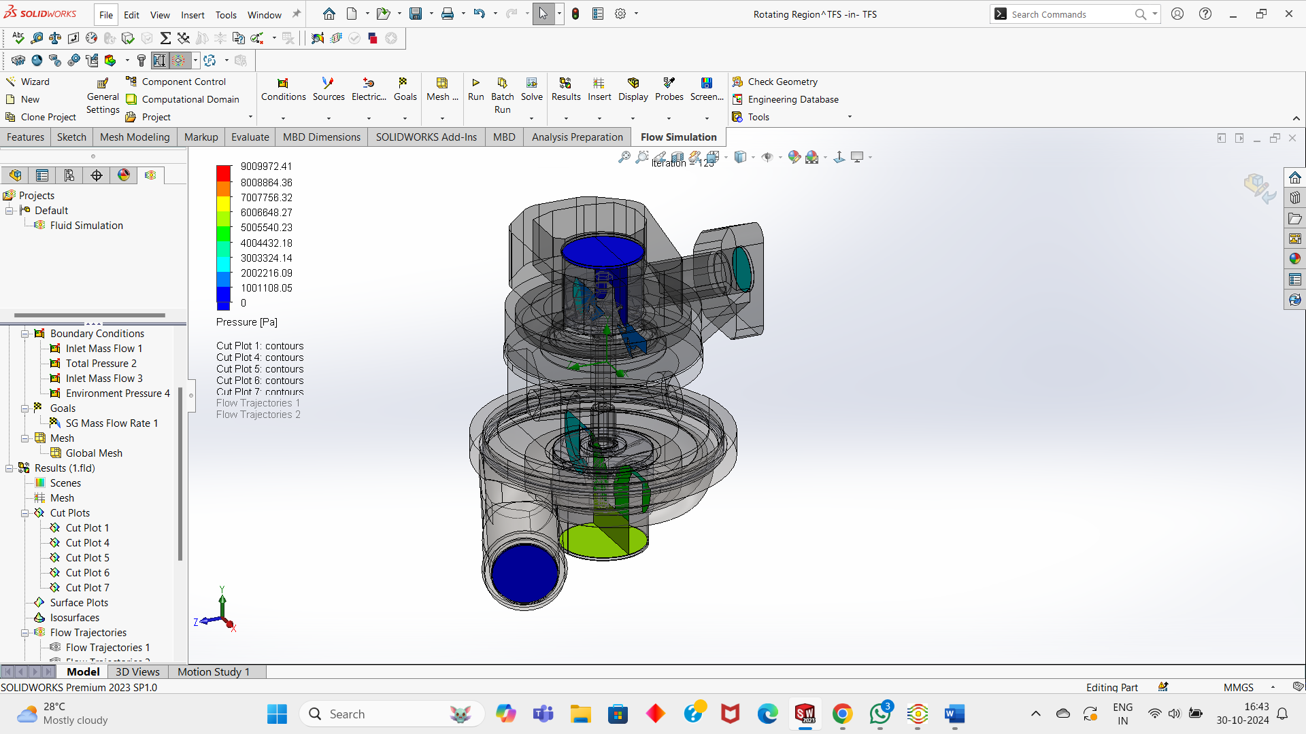

Slide 30
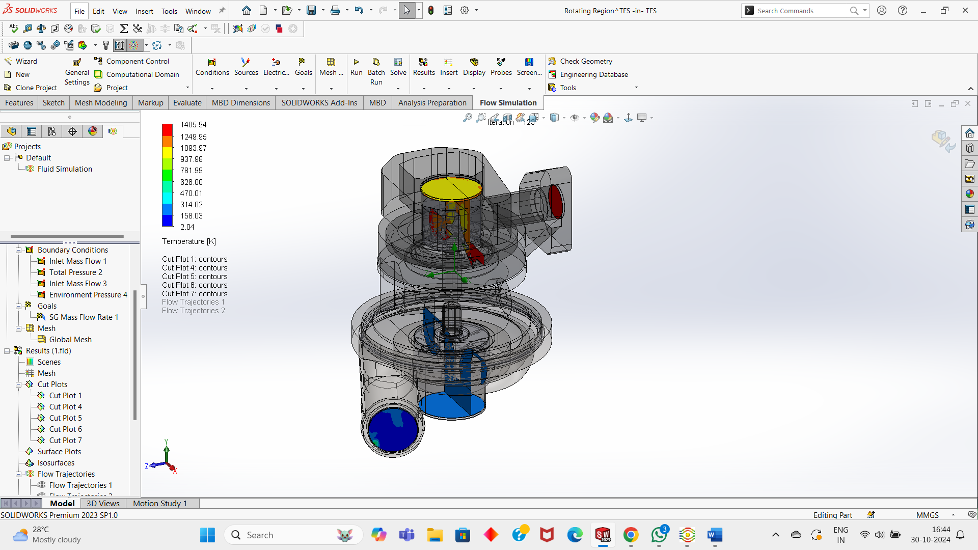

Slide 31
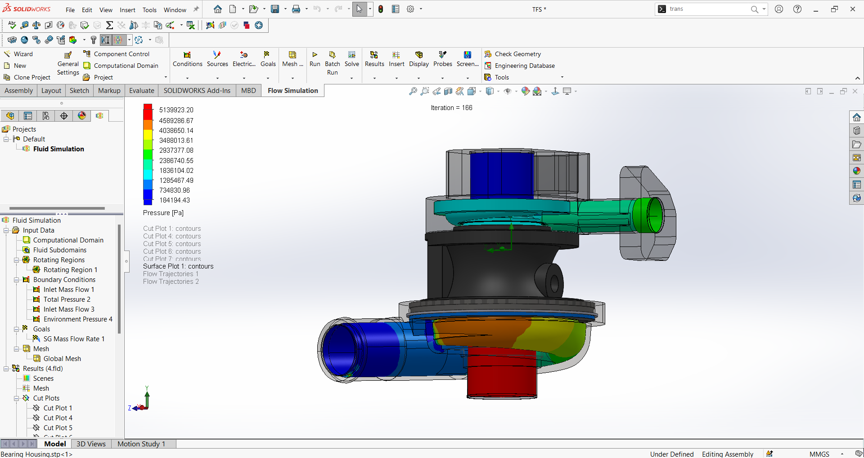

Slide 32
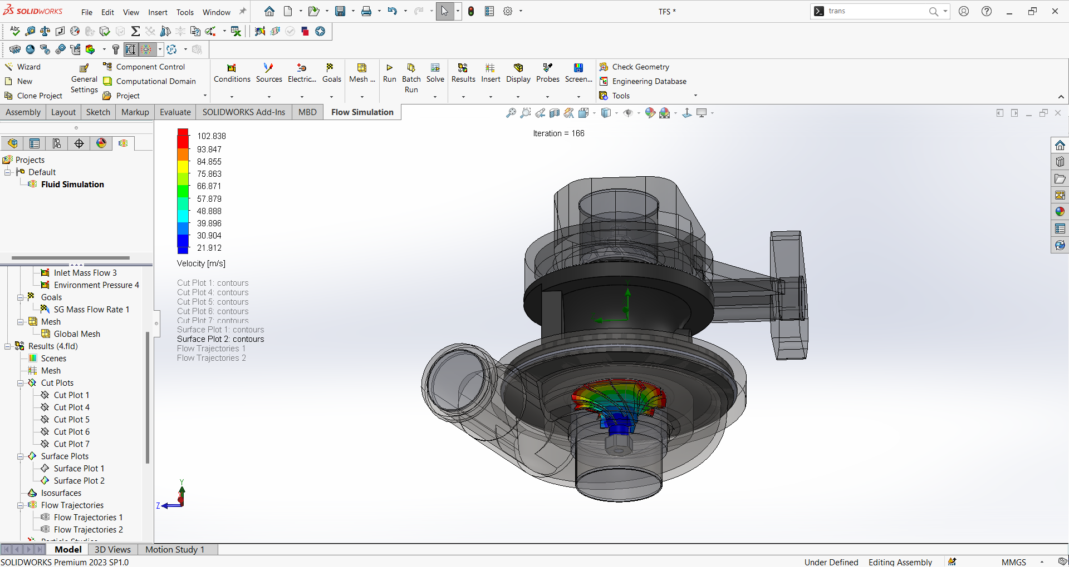

Slide 33
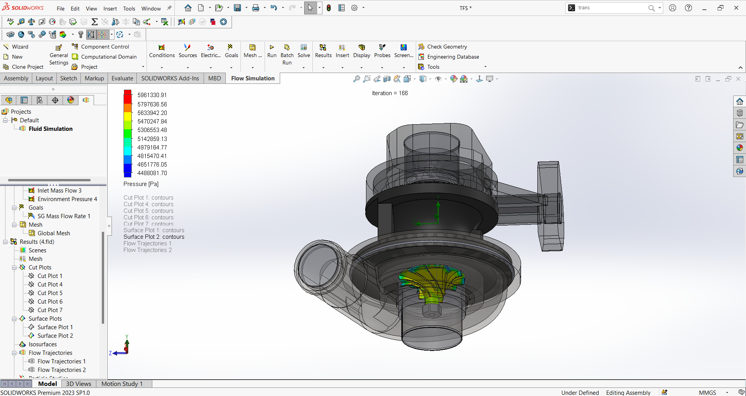

Slide 34
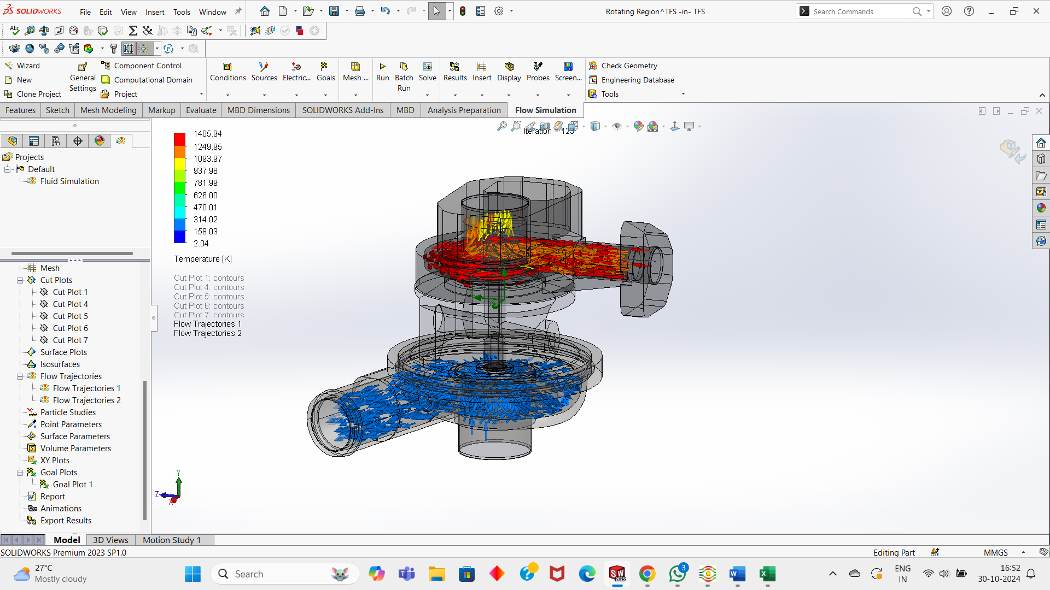

Slide 35
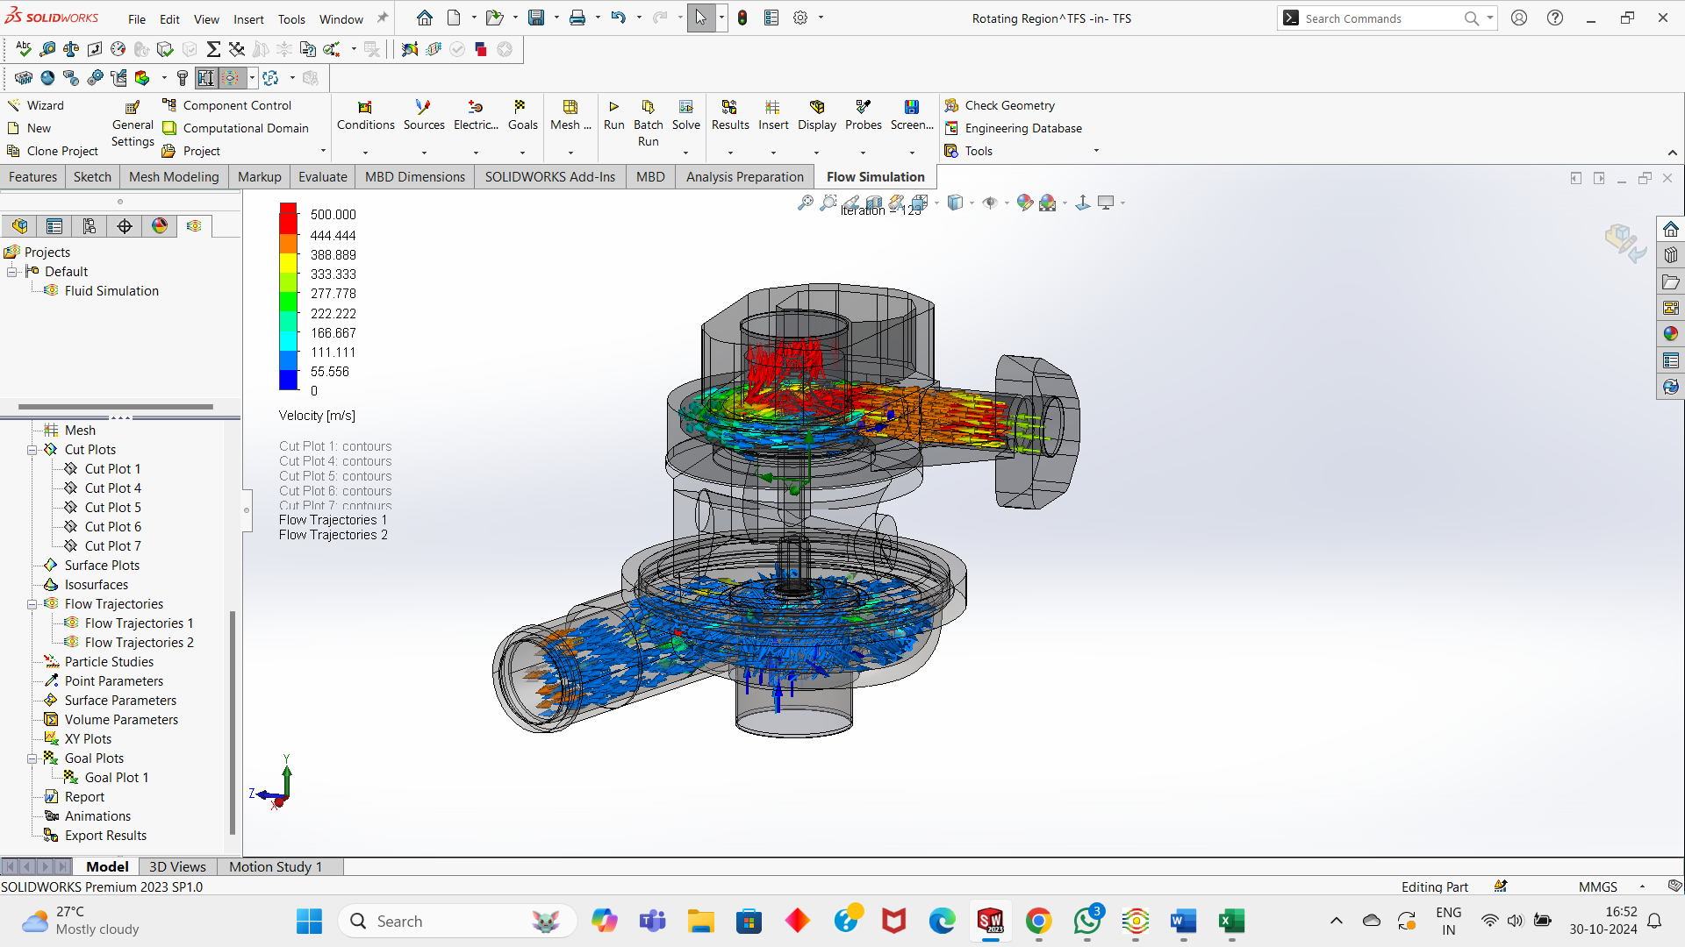

Slide 36
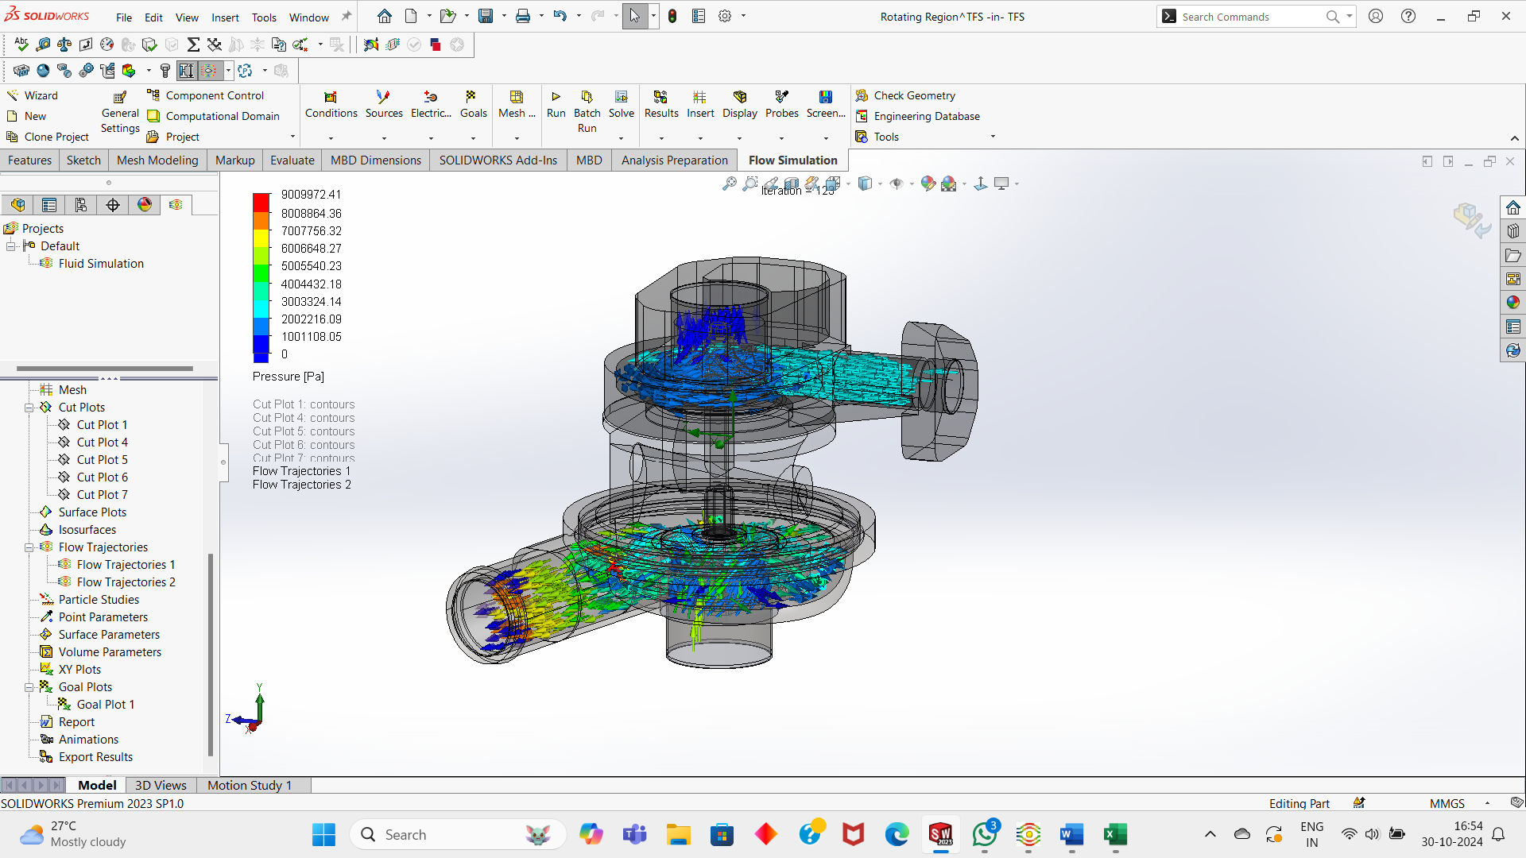

Slide 37
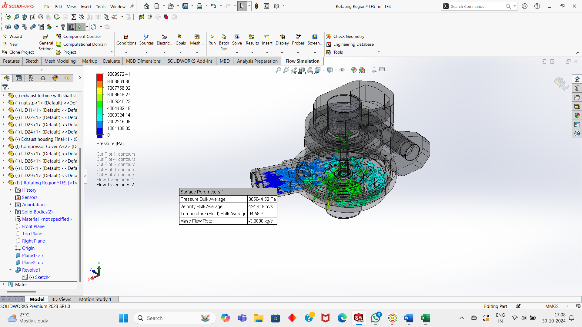

Slide 38
Inferences Drawn
The velocity at the outlet from compressor is found to be 424.19 m/s.
Pressure at outlet from compressor is calculated to be 385 Kpa.

Slide 39
Compressor Cover

Slide 40
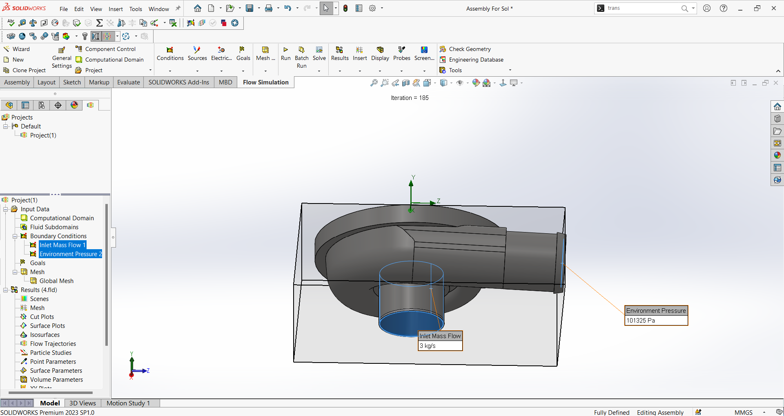

Slide 41
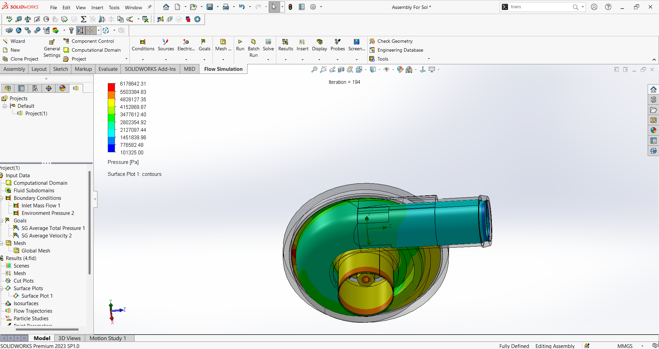

Slide 42
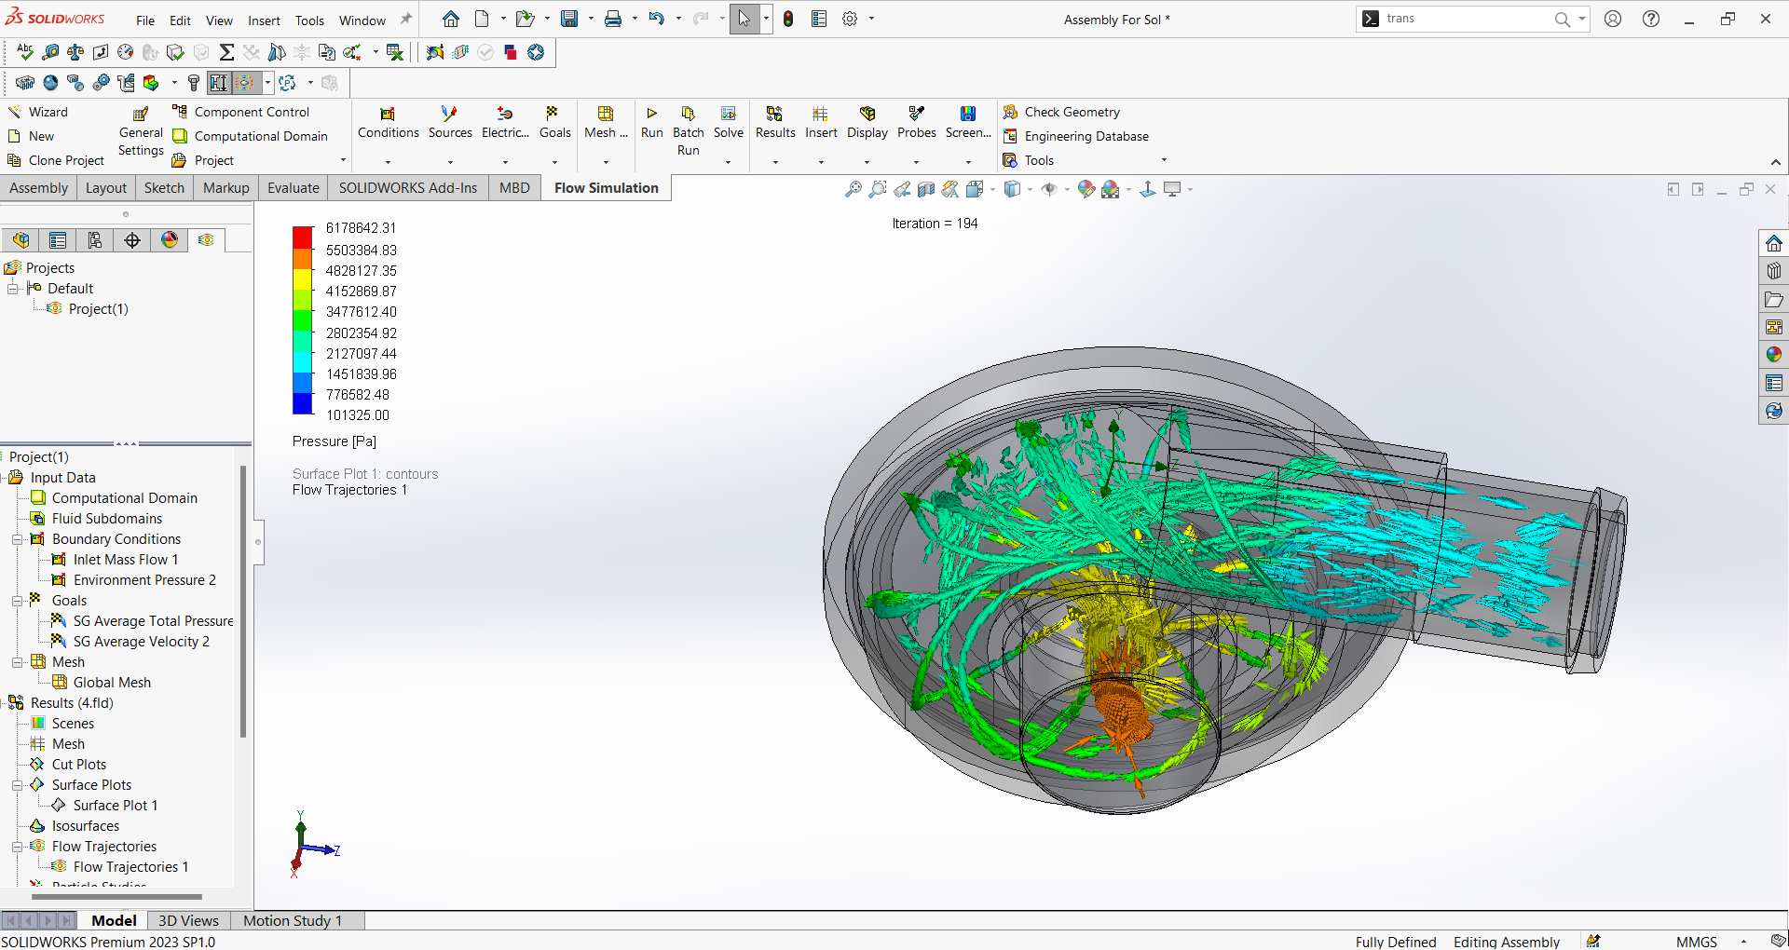

Slide 43
Inferences Drawn
The inlet mass flow for compressor cover is 3kg/s.
The maximum pressure experienced is at the inlet and decreases along the path.

Slide 44
Compressor Wheel

Slide 45
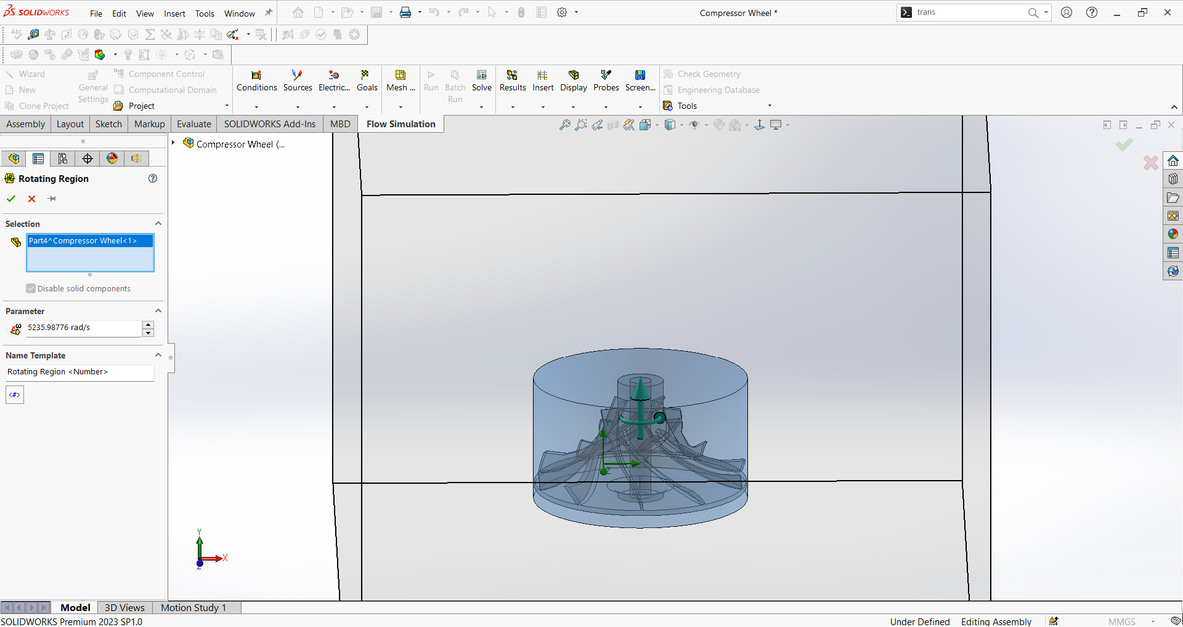

Slide 46
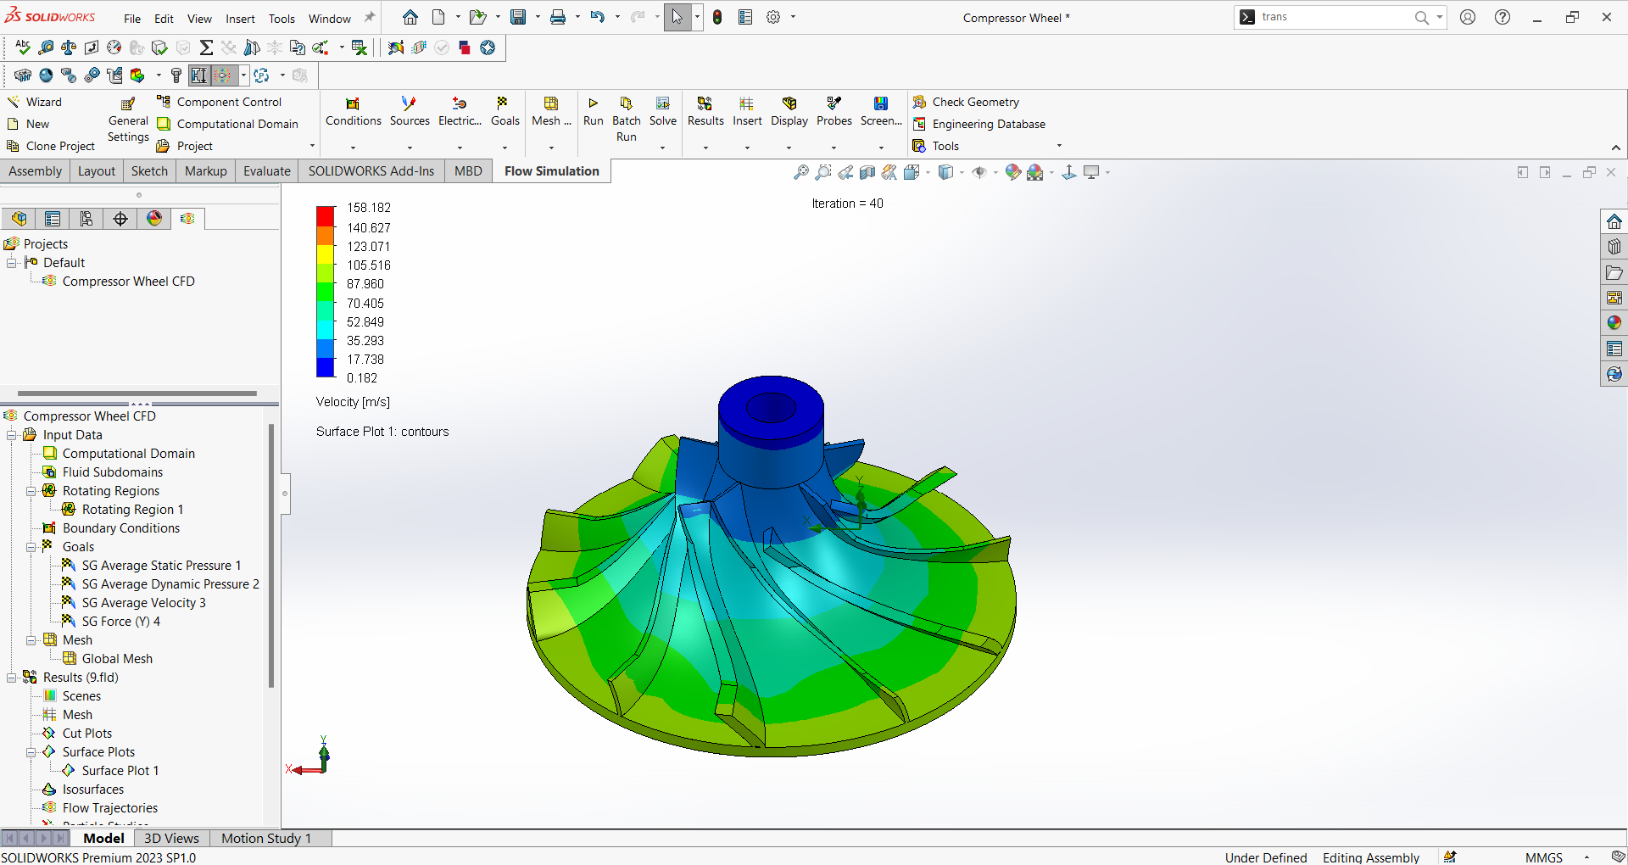

Slide 47
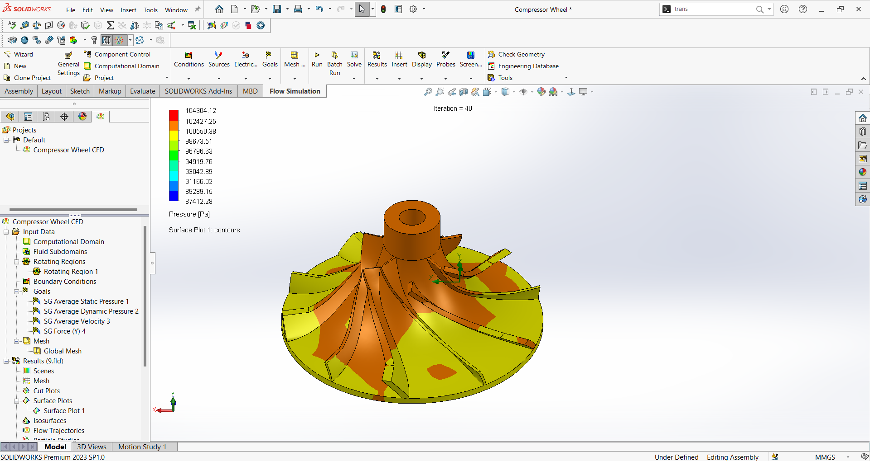

Slide 48
Inferences Drawn
The maximum pressure experienced by the compressor wheel is 104 Kpa and minimum is 84 Kpa.
The maximum pressure is experienced at centre of compressor wheel i.e. at the top of the wheel and decreases as it goes down.
The maximum velocity experienced is 105 m/s.
The maximum velocity is also experienced at top of compressor wheel.

Slide 49
Results

Slide 50
Exhaust Housing

Slide 54
Compressor Cover

Slide 55
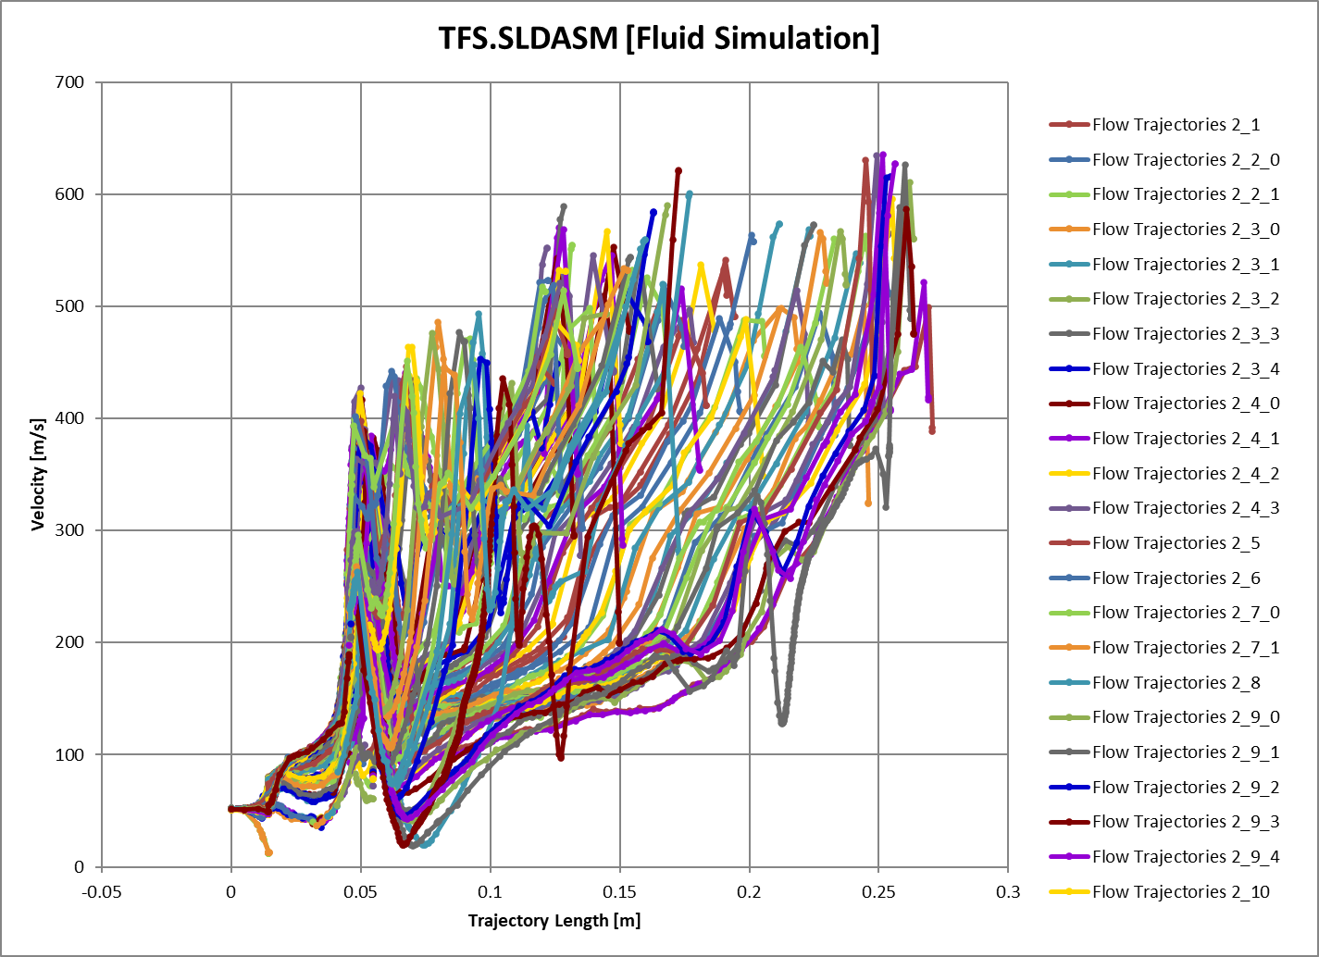

Slide 56
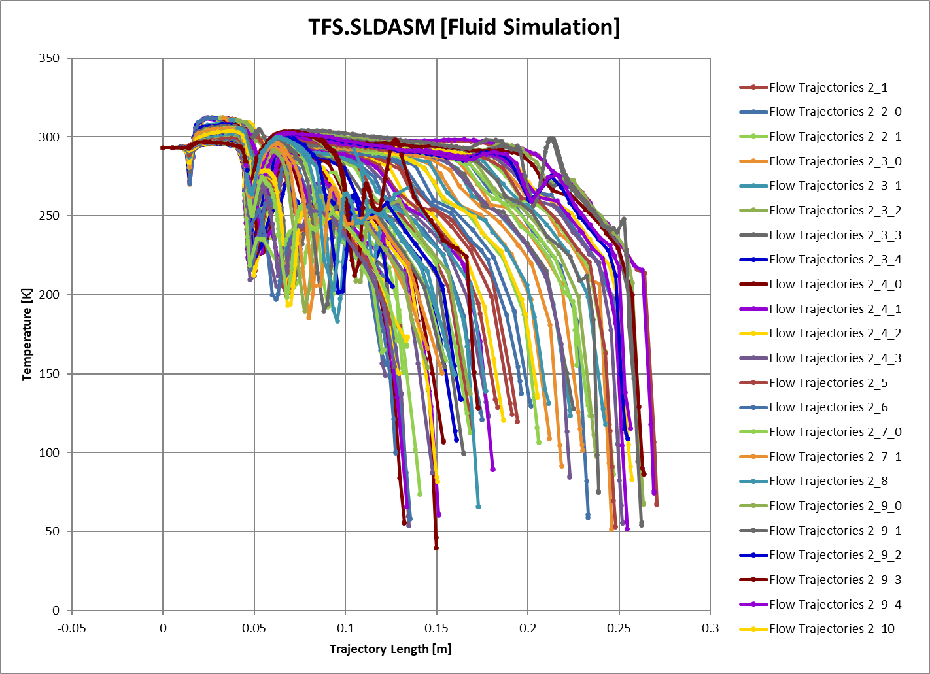

Slide 57
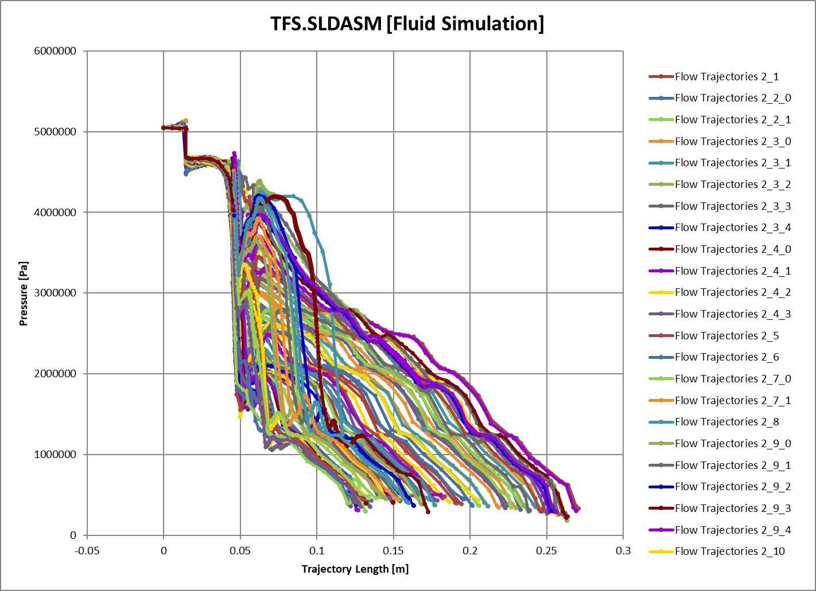

Slide 58
Thank You

